Slide 1


Scrum-Agile Approach
Christopher King
Southern New Hampshire University
CS-250 Software Development Lifecycle
Professor Rangitsch
August 13, 2023

Slide 2




Scrum-Agile Team
Product Owner
Scrum Master
There are four key roles on a Scrum-Agile team. There can be multiple people in the tester and developer roles.
Tester
Developer

Slide 3

Product Owner
Manage and clarify project requirements.
Manage scrum product backlog.
Work with stakeholders and manage their expectations.
Develop a product strategy.
Keep the client updated on project.
“The product owner may do the above work or have the Development Team do it. However, the product owner remains accountable.” (Cobb, 2015)

Slide 4

Scrum Master
Inspire staff at the right moments.
Helps the Product Owner arrange the product backlog to maximize value.
Keeps the team safe from anything that can interrupt their work.
Typically trained or certified in Scrum Methodology.
Typically runs Daily Scrums.
Assists with Sprint review and retrospective.

Slide 5

Tester
Creates test cases to ensure product meets client/user needs.
Provide feedback on test status, test progress, and product quality.
Update test cases as needed.
Train or couch other members of the team in relevant aspects of testing and quality.

Slide 6

Developer
Cross-functional and self-organizing.
Resolve product issues in a realistic way.
Ensure shippable items are delivered on time during product iterations.
Team consisting of 3 – 9 members.
Team players.

Slide 7
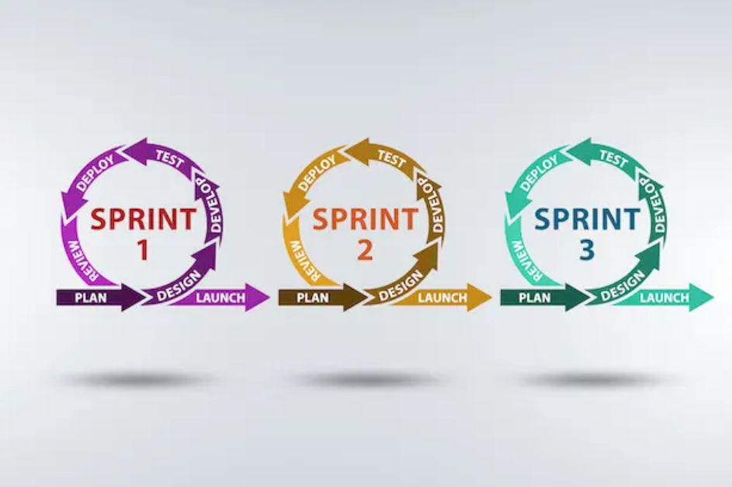
Agile Phases
Plan Requirements
With input from the client and product owner, a project is broken down into multiple sprints.
Design and Develop Product
Design and development of each sprint is completed in order of priority.
Test
Each sprint is tested as it is being completed.
Deploy
The sprint iteration is delivered.
Review
A review of each sprint is completed before starting the next sprint. This ensures any issues from the previous sprint will not be passed on to the next sprint.
Blake, S. (2021, February 11). Your guide to agile software development life cycles. Easy Agile. https://www.easyagile.com/blog/agile-software-development-life-cycle/

Slide 8
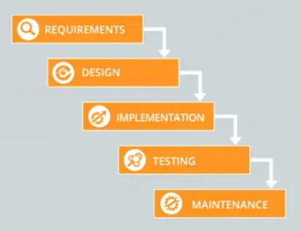
Waterfall Phases
Requirements
Initial planning process where the team gathers as much information as possible to ensure the project is successful. At the end of this stage we will know each stage of the process, who is working on each stage, key dependencies, required resources, and a timeline for each stage.
Design
A high-level design where the team creates a skeleton of how the software will work and how information will be accessed.
A low-level design where the team builds more specific parts of the product.
Implementation
Where the code is created.
Testing
QA testers look for any bugs or errors that need to be fixed.
Ensure product meets customers expectations.
Deployment
Product is released to the end-user.
Maintenance
Any bugs discovered after deployment are fixed via updates.
Singh, M. (2022, December 22). Moving from waterfall to agile with Kanban. Nimblework. https://www.nimblework.com/blog/waterfall-to-agile-with-kanban/

Slide 9

Agile vs Waterfall
Agile Method
Waterfall Method
Iterative development
Delivery every two weeks
Built upfront with standards
Constant and fast feedback
Depending on shared experiences
Development
Progress
Quality
Feedback
Teamwork
Sequential development
Delivery stage by stage
Extensive testing at the end
Mor tolerant of late learning
More autonomy and independence

Slide 10
Decision between Agile and Waterfall
When to choose Waterfall approach
When rigidity is needed instead of flexibility. Banks, manufacturing, and defense tend to benefit from ridged structures.
When project requires comprehensive documentation.
When collaboration with client is not needed.
When to choose Agile approach
When flexibility is needed to adapt to possible late changes in the project.
When collaboration with clients is important.
When continuous delivery of working software is needed.

Slide 11

References
Blake, S. (2021, February 11). Your guide to agile software development life cycles. Easy Agile. https://www.easyagile.com/blog/agile-software-development-life-cycle/
Singh, M. (2022, December 22). Moving from waterfall to agile with Kanban. Nimblework. https://www.nimblework.com/blog/waterfall-to-agile-with-kanban/
Charles G. Cobb. (2015). The Project Manager’s Guide to Mastering Agile : Principles and Practices for an Adaptive Approach. Wiley.

